Slide 1

Implementing Appropriate Reliance in a Cognitive AI Architecture
A Technical Implementation with Research Opportunities
Fabio Correa | Microsoft Corporation | February 2026

Slide 2
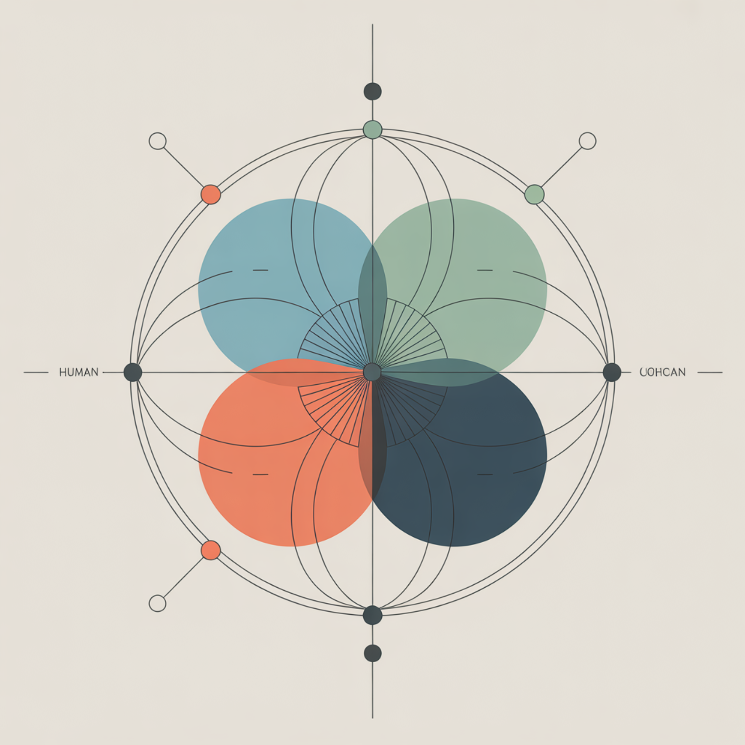
RESEARCH PROBLEM
Miscalibrated Confidence Undermines Human-AI Teams
Dell'Acqua et al. (2023) documented a surprising finding: Human+AI teams can perform worse than either alone when reliance is miscalibrated.
Two Interrelated Failures
Hallucination: AI generates plausible but incorrect information
Over-reliance: Users accept without critical evaluation
Root cause: No signals for when to trust versus verify.

Slide 3
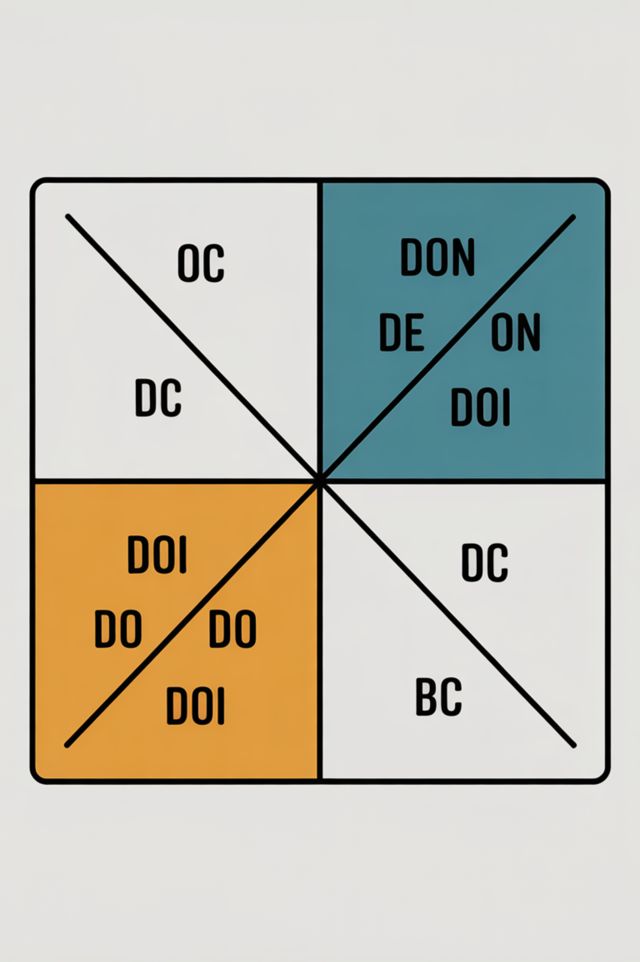
AETHER SYNTHESIS
What Does "Appropriate Reliance" Mean?
From Passi, Dhanorkar, & Vorvoreanu (2024) — approximately 50 papers reviewed:
Definition
CAIR Component
Users accept correct AI outputs AND reject incorrect ones
Correct AI-Reliance: Trust AI when AI is right
CSR Component
Correct Self-Reliance: Trust self when AI is wrong
Metric: AoR = 1 indicates optimal calibration (Schemmer et al., 2023)

Slide 4
EVIDENCE BASE
Research-Validated Interventions
Intervention
Effect
Source
Key Pattern
Interventions that make AI uncertainty visible and actionable consistently improve calibration across diverse contexts.
AI self-critiques
+50% error detection
Saunders et al. (2022)
Contrastive explanations
+20% accuracy when AI wrong
Si et al. (2023)
Most effective: combining multiple mechanisms rather than single interventions.
Background explanations
61% → 47% incorrect acceptance
Goyal et al. (2023)
Low-confidence expressions
-25% false user confidence
Steyvers et al. (2024)
Uncertainty highlighting
+100% error detection
Spatharioti et al. (2023)

Slide 5
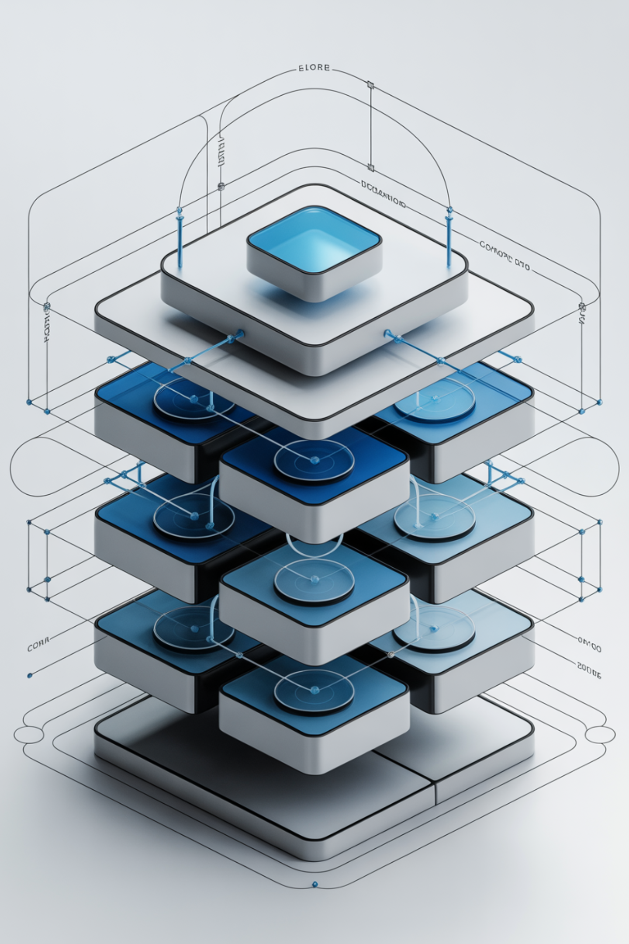
The Alex Implementation
A Living Testbed for Appropriate Reliance Mechanisms
Structured Memory Systems
Multi-Platform Deployment
Procedural, episodic, and domain knowledge components
VS Code for developers, M365 for knowledge workers
Embedded AR Protocols
Confidence calibration, source grounding, mode separation
Currently deployed with approximately 7,000 lines of AR-specific protocol code, enabling systematic investigation of calibration mechanisms in production contexts.

Slide 6


KEY INNOVATION
Epistemic vs. Generative Modes
Not All AI Output Needs the Same Calibration
Epistemic Mode
Generative Mode
Factual claims and verifiable statements
90% confidence ceiling maximum
Source grounding required
Language: "According to documentation..."
User trigger: /verify command
Creative ideas and brainstorming
Collaborative validation approach
Proposal framing encouraged
Language: "Here's an idea to explore..."
User trigger: /creative command
Key insight: Applying epistemic constraints to creativity impoverishes collaboration. Different modes optimize for different outcomes.

Slide 7
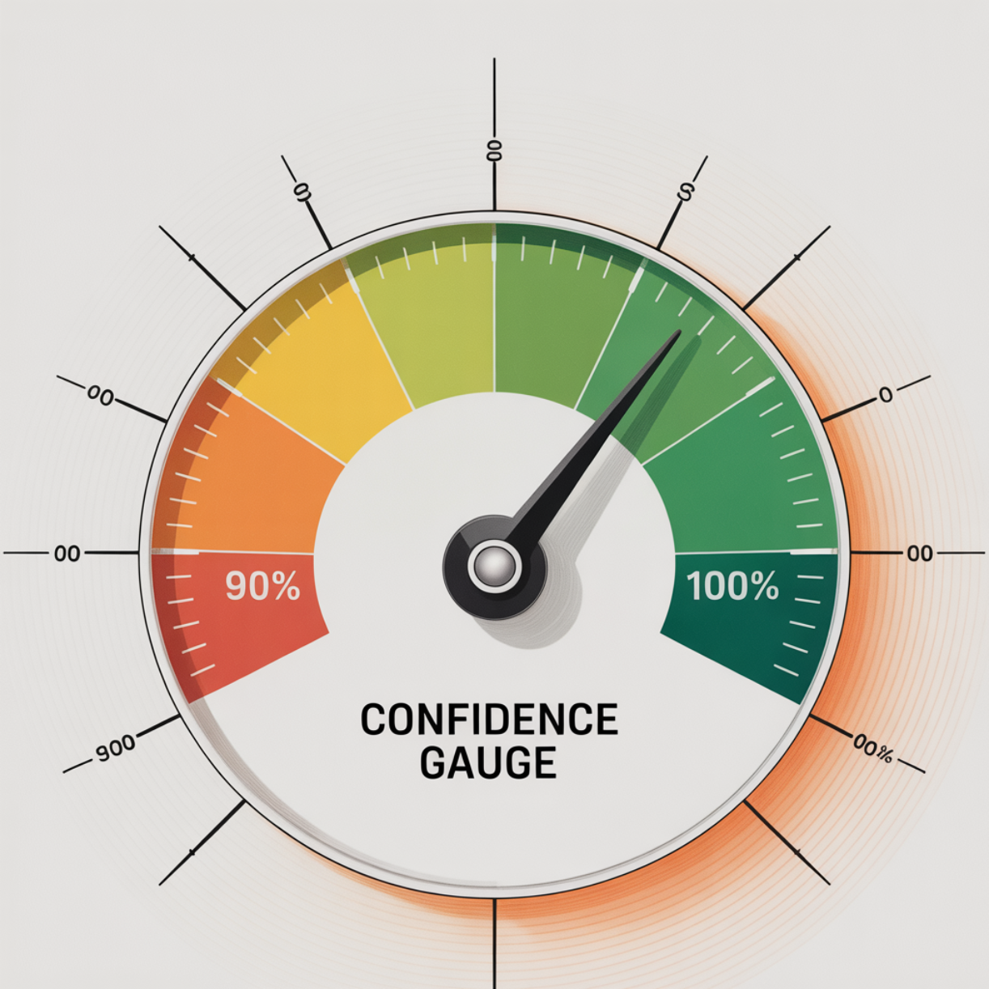
Confidence Ceiling Protocol
Never Claim What You Can't Support
Based on Lin et al. (2022) — models can verbalize calibrated uncertainty when properly instructed.
Content Type
Maximum Confidence
Direct file reading
100%
Documented patterns
90%
Factual without source
70%
Inference/edge cases
50%
The 90% ceiling communicates: "This should work, but verify in your specific context."

Slide 8

Human Judgment Flagging
Some Decisions Require Human Authority
AI systems should inform but not decide on matters requiring human values, accountability, and contextual judgment:
Business Strategy
Ethical Dilemmas
Personnel Decisions
Priorities and strategic direction
Values-based tradeoff decisions
Hiring, promotion, termination
Security Architecture
Legal/Compliance
Risk tolerance and protection levels
Regulatory interpretation and application
Flagging pattern: "I can outline the options, but the choice depends on your priorities around [tradeoff]."

Slide 9
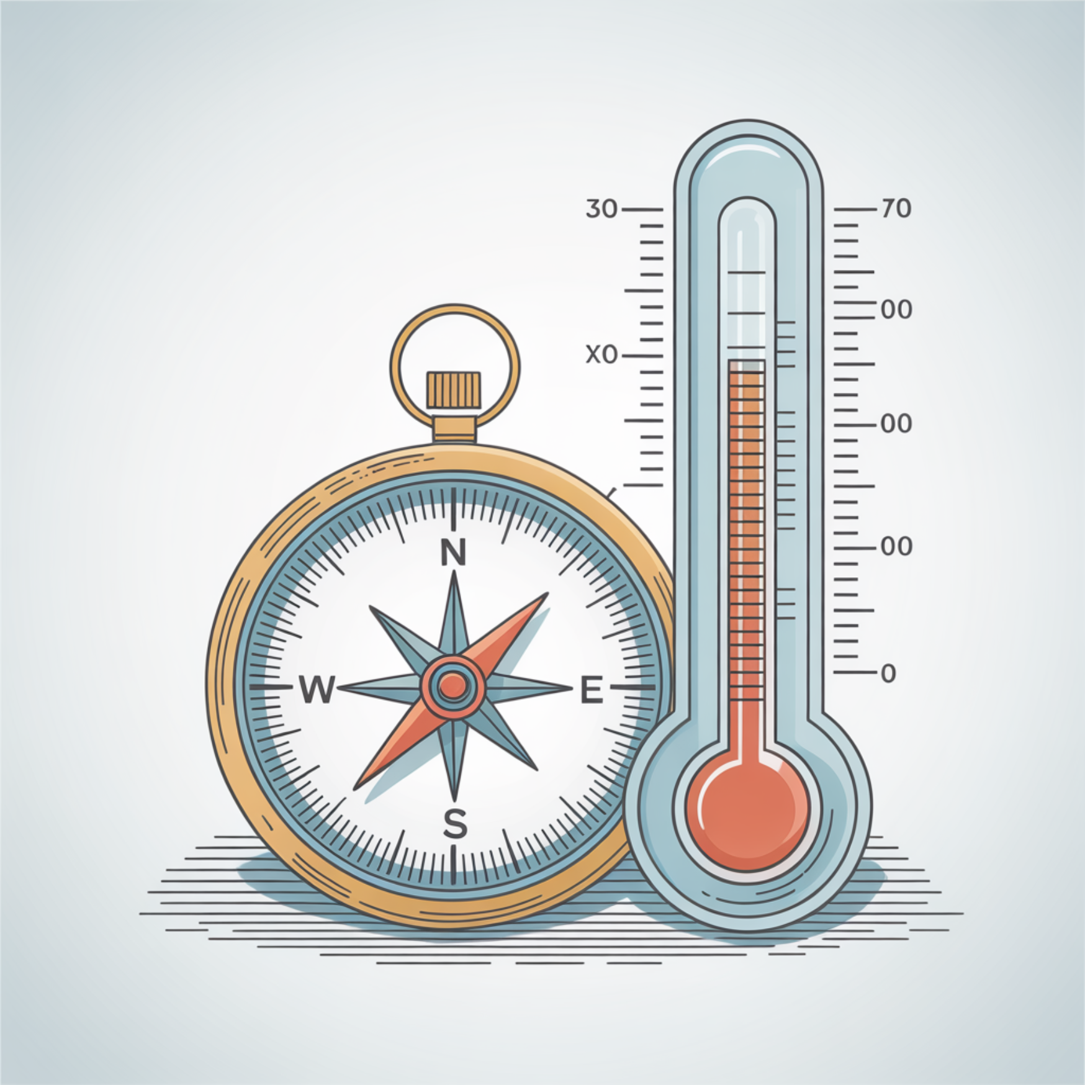
RESEARCH FINDING
The AIRS-16 Finding
Trust Level May Not Be What Matters
AIRS-16 validated instrument (N=523) measures 8 constructs predicting AI adoption behavioral intention.
Surprising result: Trust in AI (TR) was only marginally significant: β=.106, p=.064
Provocative Question
Is it not how much you trust AI that predicts adoption, but how well your trust is calibrated to actual AI capability?
This suggests we may have been measuring the wrong construct for predicting successful human-AI collaboration.

Slide 10
Trust ≠ Appropriate Reliance
Two Orthogonal Constructs
Critical Distinction
Trust (TR)
Appropriate Reliance (AR)
A user can score HIGH on TR + LOW on AR = dangerous over-reliance profile.
Trust level
Trust calibration
Conversely, HIGH AR with MODERATE TR may represent the optimal profile for effective human-AI collaboration.
"Do you trust AI?"
"Can you discern when trust is warranted?"
Attitude
Metacognitive skill
Low TR → under-utilization
Low AR → over-reliance OR under-reliance

Slide 11
PROPOSED EXTENSION
AIRS-18 Extension
Adding Appropriate Reliance to the Instrument
New Item AR1
New Item AR2
"I can tell when AI-generated information is reliable and when it needs verification."
"I know when to trust AI tools and when to rely on my own judgment instead."
Research Hypotheses
H1: AR shows discriminant validity from TR (HTMT < .85)
H2: AR provides incremental validity beyond AIRS-16 (ΔR² > .02)
H3: AR moderates the TR→BI relationship

Slide 12



Platform Comparison Opportunity
Natural Experiment: Developers vs. Knowledge Workers
VS Code Deployment
M365 Copilot Deployment
Population: Software developers
Mode commands: Explicit /verify, /creative
Verification: Direct code execution
Interaction: Multi-turn scaffolds
Population: Knowledge workers
Mode commands: Implicit inference
Verification: Limited to search
Interaction: Single-turn responses
H1: VS Code Alex outperforms M365 Alex on AR metrics due to richer interaction affordances and explicit calibration mechanisms.

Slide 13
METHODOLOGICAL CHALLENGES
Measurement Challenges
The Hard Problems
Challenge
Description
Potential Approach
No ground truth
Can't always know if AI was correct
Strategy-graded approach (Fok & Weld, 2023)
Self-report limits
AR items measure perceived calibration
Behavioral validation with task studies
Selection bias
Developers self-select into VS Code
Control for domain expertise
Domain specificity
AR may vary by task type
Modular measurement by context
Key question: How do we measure AoR without ground truth for open-ended tasks?

Slide 14
Collaboration Opportunities
Research Questions We're Exploring
01
02
03
Calibration Measurement
Mode Detection
Intervention Timing
How to measure AoR without ground truth in open-ended domains?
Can we automatically detect when to switch between epistemic and generative modes?
When should cognitive forcing functions interrupt versus support flow?
04
05
Longitudinal Effects
AIRS-18 Validation
Does appropriate reliance decay over time with increased familiarity?
Does AR provide incremental validity in predicting collaboration outcomes?

Slide 15
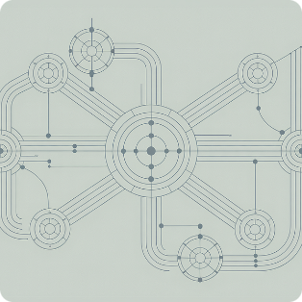
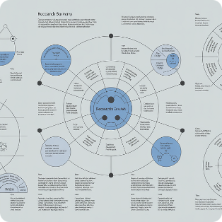
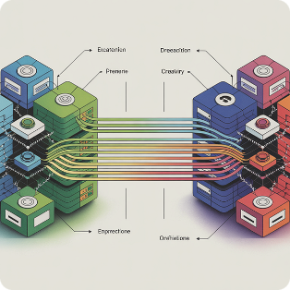
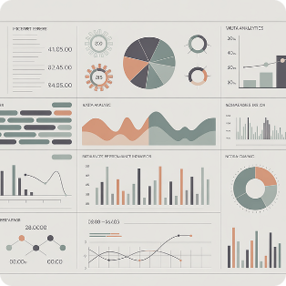
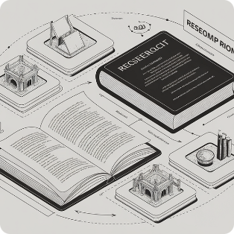
NEXT STEPS
What I'm Bringing to This Conversation
Assets Available for Research Collaboration
Alex Implementation
AIRS-16 Instrument
Two Platforms
Instrumentation Hooks
Production cognitive architecture with embedded AR protocols
Validated scale (N=523), deployed at airs.correax.com
VS Code + M365 for cross-population comparison
Ready for telemetry on AR behaviors and outcomes
Article Draft
Version 5 comprehensive scholarly treatment (≈1100 lines)
Looking for: Measurement expertise, validation study design, Microsoft Research alignment on human-AI collaboration priorities.
"AI can bridge gaps of time, distance, and scale, but only if built correctly."
— Jaime Teevan, Microsoft Chief Scientist

